Slide 1
Iteration 1 - Software Design
Team : 4
Team Leader: Ray Clark
Requirement Leader: Chen Zhao
Design and Implementation Leader: Daniel Graziano
QA Leader: But Wing Han Josephine
Configuration Leader: Huimin Diao
Security Leader: Zixia Zhou

Slide 2
Software Design Introduction
Application Overview
Research: According to the National Health & Nutrition Examination Survey (2013–2014), approximately 2 in 3 adults in the U.S. are either overweight or obese.
App: MyDietHub is a full stack application built on modern frameworks that allows a user to compute the calories of a given food type and for an entire meal.
Purpose: The purpose of the application is to allow a user to track their caloric intake and thereby regulate their diet.
Users: Any person hoping to regulate their caloric intake and track their diet.

Slide 3
Software Design Goals
Design Goals Overview
First, we will focus on an architectural structure that will satisfy the stated system requirements.
Second, we will attempt to implement a design that will be flexible and enable us to easily make changes as necessary.
Lastly, we will integrate various software qualities such as usability, reliability, scalability and security.

Slide 4
Software Design Goals - Specific
External Quality Characteristics
Efficiency – Measured by response time and throughput
Reliability - Measured in terms of mean time failure, i.e., up-time
Security – Integrating measures to protect against malicious attacks
Internal Quality Characteristics
Maintainability – Ease of revising and/or enhancing the system
Re-usability – Use OOD to ensure reuse of code
Portability - Accessible across different platforms

Slide 5
Software Architecture
Overriding Goal - Decompose the software system into smaller subsystems (components) to reduce system complexity while allowing for change.
Subsystems (components) are structured or decomposed based on functions and data flow.
Example 1: User related classes will be grouped into a User Package with similar functionality.
Example 2: The system will feature both “FoodItem” and “Meal” classes, each of which will maintain data about the food or meal. These are grouped in a single package based on similar functionality.

Slide 6
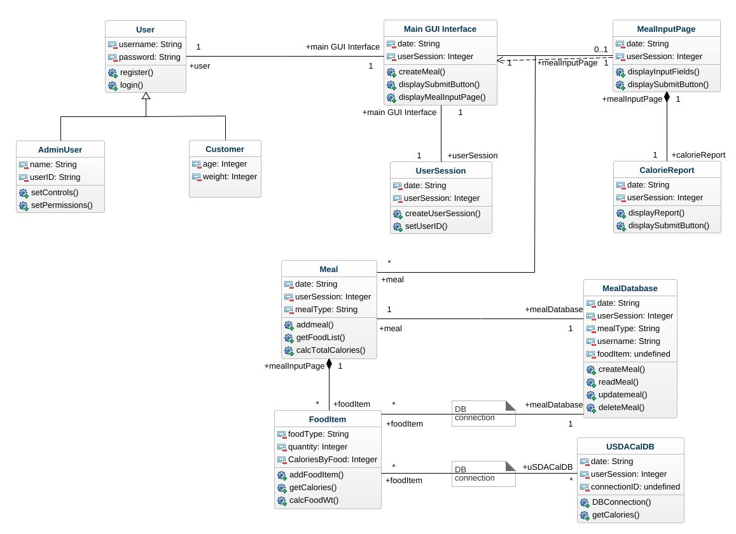
Class Diagram

Slide 7
Database Design
SQLite chosen for simplicity and integration with python/flask
Schema Highlights:
“User” database has 9 keys: id, firstname, lastname, email, username, password, gender, weight and height. Will be used for the calculation of BMI
“Food” can make sure the MyDietHub could find the calorie for each kind of food. And “Counter” can calculate the calorie for each meal with given data.
“Nutrition” database has the following keys: userID, food, portion, calories, dateAdded

Slide 8
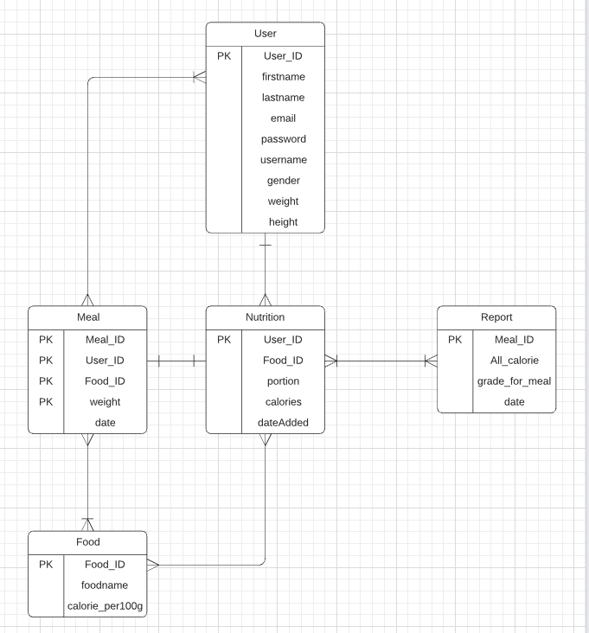
Database Design

Slide 9
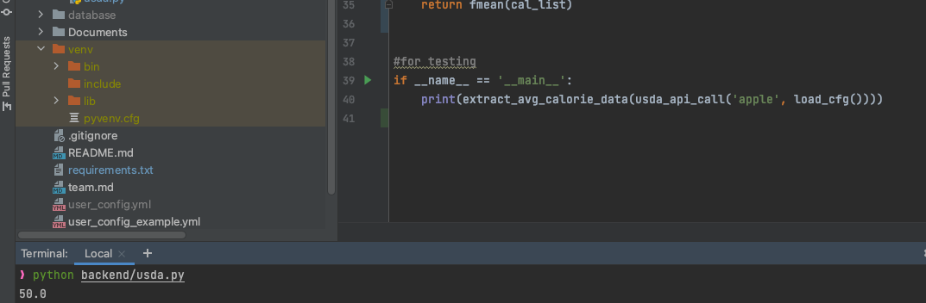
Backend Callback Functions
Extract_avg_calorie_data - Access USDA API and search for food via formatted query, also load user config file to get USDA API keys and email account.

Slide 10
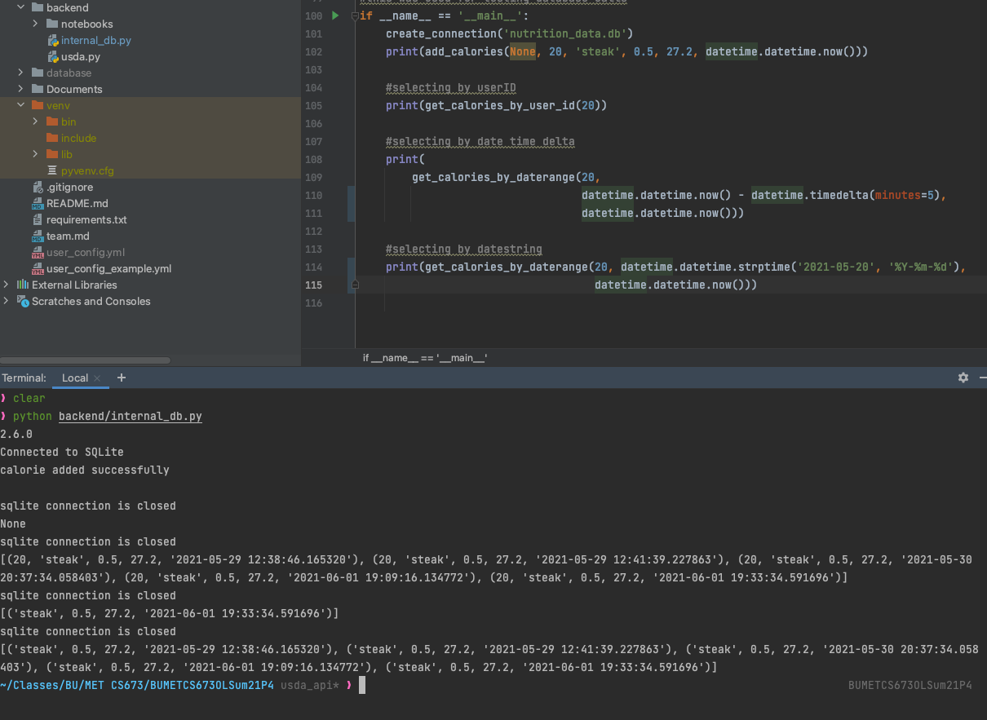
Backend Callback Functions
create_connection - instantiate database with desired schema
get_calories_by_user_id - query database to retrieve foods by unique user ID
get_calories_by_daterange - query database by user ID over a specified date range. This would be used for retrieving calorie data for CalorieReport class

Slide 11
Security
Password Hashing
We use Flask-login, Werkzeug and we are going to use the method PBKDF2 (method='pbkdf2:sha256') to do the password hashing.
PBKDF2 is a simple cryptographic key derivation function. The PBKDF2 algorithm is described in the Internet standard RFC 2898 (PKCS#5).
API Keys Security
To ensure that API keys we used to fetch the data from USDA are not exposed in our public code repository.

Slide 12
Software Design Patterns
Design patterns can be broken down into 3 categories:
Creational patterns: design patterns about class or object creation, including abstract factory, builder, factory method, prototype, singleton, etc.
Structural patterns: design patterns about class and object composition, including adapter, bridge, composite, decorator, facade, proxy, etc.
Behavior patterns: design patterns about class or object communication, including command, interpreter, observer, state, strategy, template method, etc.

Slide 13
Software Design Patterns - Specific
Design patterns can be broken down into 3 categories:
Factory Pattern: Factory pattern, we create an object without exposing the creation logic to the client and refer to the newly created object using a common interface.
The Factory Pattern will be used to create different types of meals for the user.
Singleton Pattern: The pattern involves a single class which is responsible for creating an object.
The Singleton Pattern will be used to instantiate a User Session.

Slide 14
Key Algorithms
BMI calculator
USER BMI = weight(kilogram) / height^2 (meter)
Calorie Calculator
Food Type Calorie = [weight(gram)/100] * calorie_per_100gram(for each kind of food)
Meal Calories
Meal Calories = sum(each food type calorie)

Slide 15
User Interface (UI) Designs
On the following pages, we outline the various preliminary UIs for the application:
Home Page
Registration & Login
Create A Meal

Slide 16
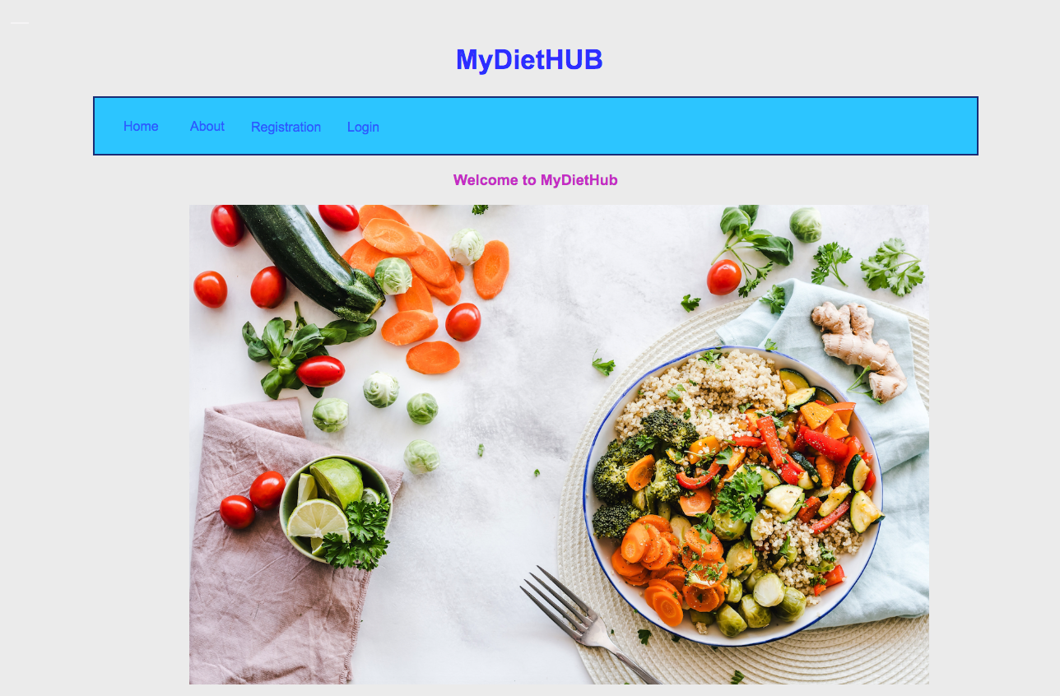
Home Page
It is a landing page (Home page).
It is a gateway to MyDietHub’s content.

Slide 17
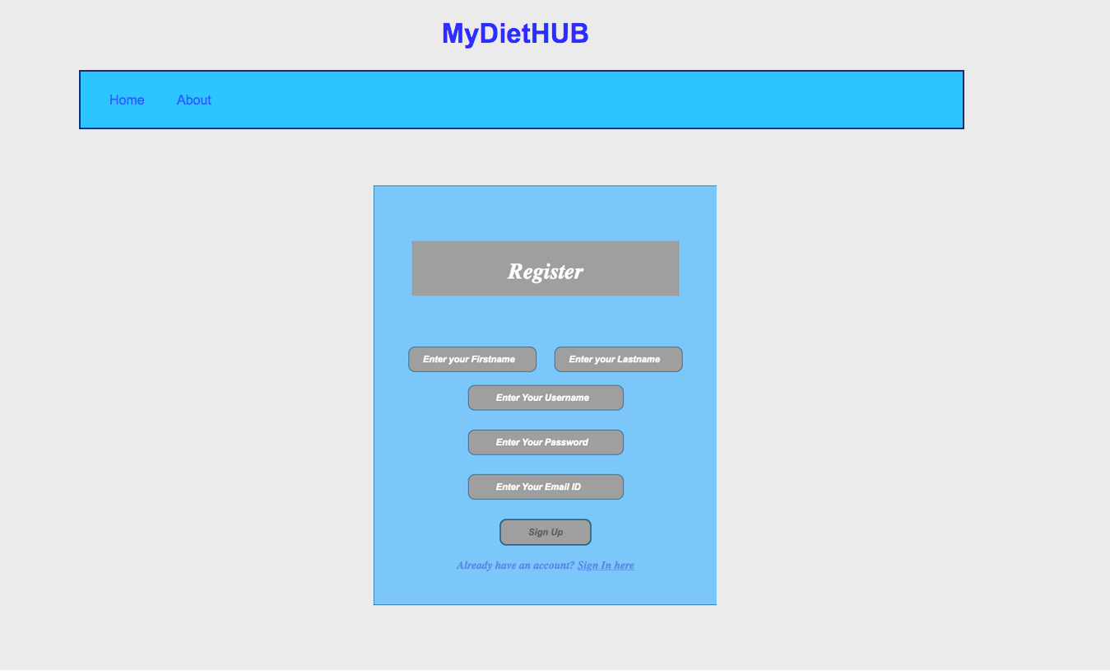
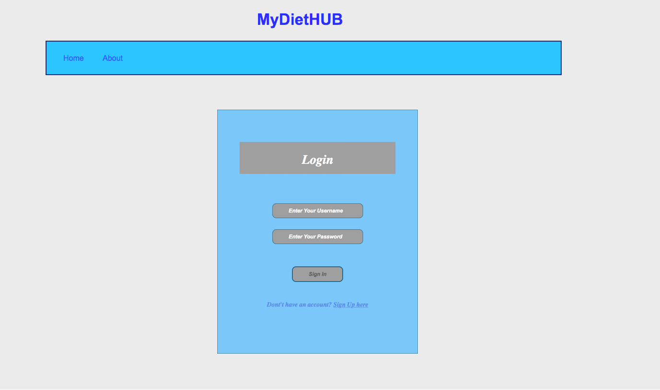
Registration/Login Page
Login form for the user to login into MyDietHub.
Registration form for the user to do registration.

Slide 18
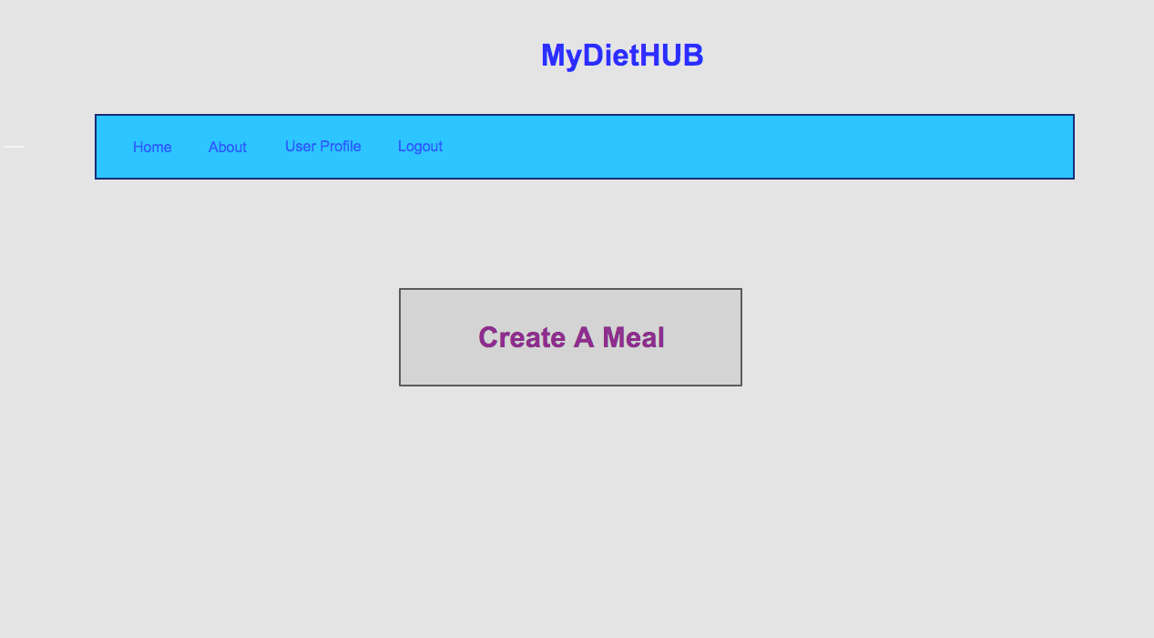
User Dashboard
User will navigate to the user’s dashboard page after login successfully.
User can click the “Create A Meal” button to navigate to the “Create A Meal/Calculate Calories” page.

Slide 19
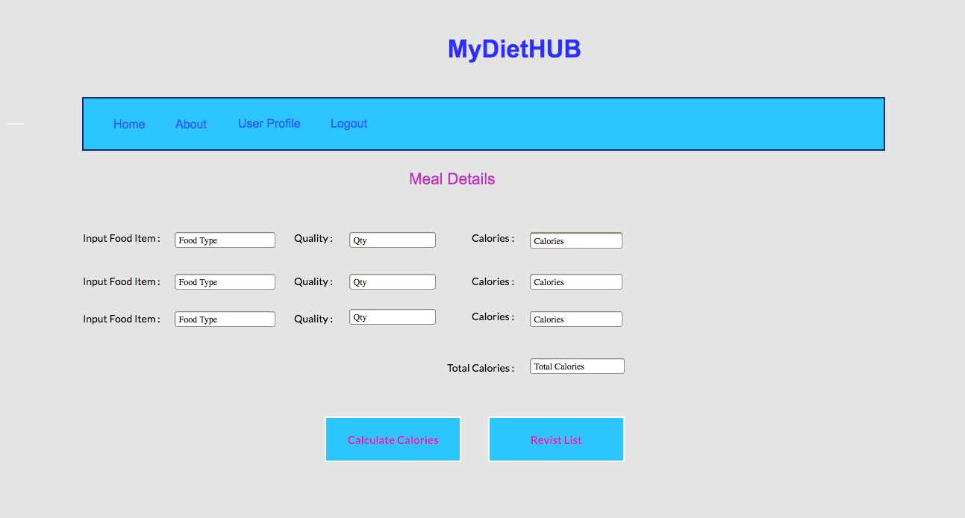
Create A Meal/Calculate Calories
User can enter the input food type and food quantity and click the “Calculate Calories” button.
The system will calculate the calories for each food type and total calories for the meal and display it on the right side column of the form.
User can click the “Revist List” button to review the food list.

Slide 20
Demo and code walk through
User Registration and Login
You can watch the code walk through and demo here :
https://drive.google.com/file/d/168Sagaas6p59Q_cNeIFf4KhiolF5iYS6/view?usp=sharing

Slide 21


